Slide 1

Affordable Helmet Design
To Reduce Rotational Acceleration

Slide 2
Background
1 Billion Cyclist in the world
Most fatal injury is incurred by the head
(Park et al., 2017)
Restraint : Helmet
Aim : Produce an affordable helmet, but provide
Linear acceleration protection
Rotational acceleration protection

Slide 3
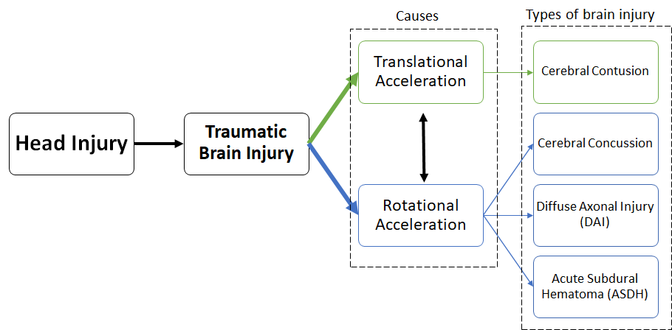
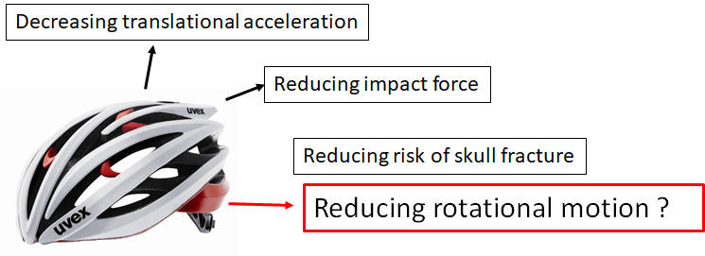

Injury Mechanism

Slide 4

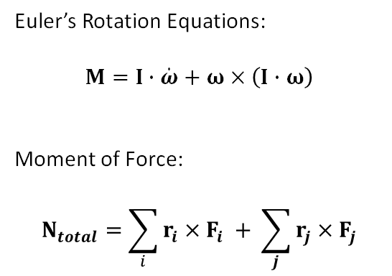
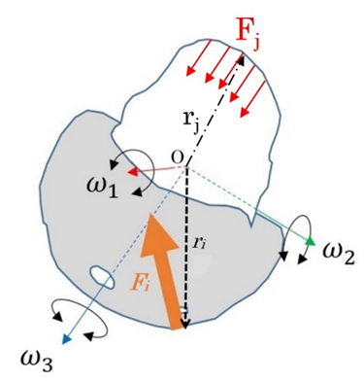




Slide 5
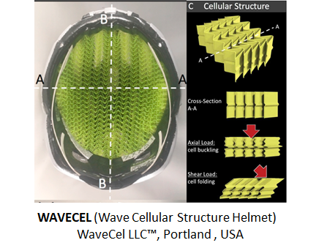
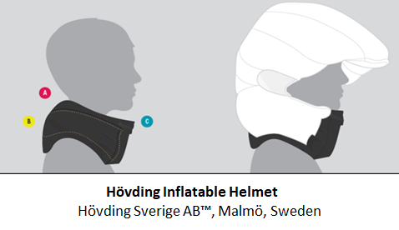
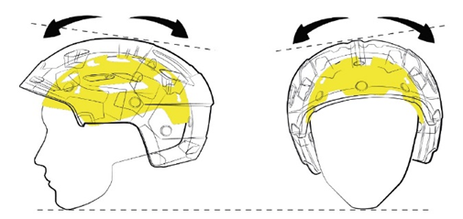


Current Solutions

Slide 6
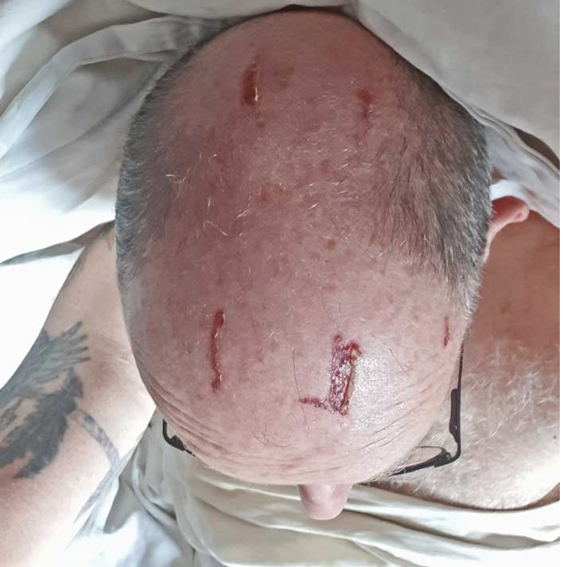
Design Criteria
Low-cost
Protection for linear acceleration
Protection for rotational acceleration
Protect all parts of head
5. Fixed to the head
6. Load should not be
shifted to neck
7. Comfortable
Current Solutions Market Price (2019)
Helmet​ | Price (USD)​
MIPS​ | >$75​
WAVECEL​ | >$150​
Hövding​ | +/- $300​
MIPS helmet user Scalp Damage

Slide 7
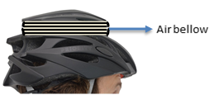
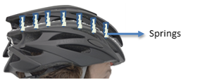
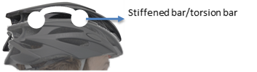
New Design

Slide 8
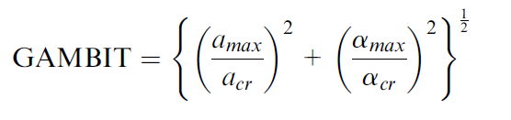
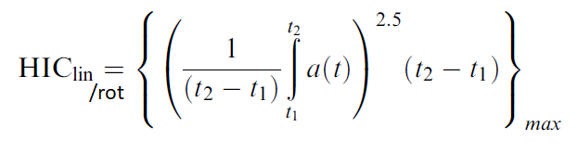
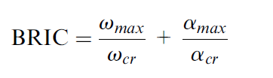
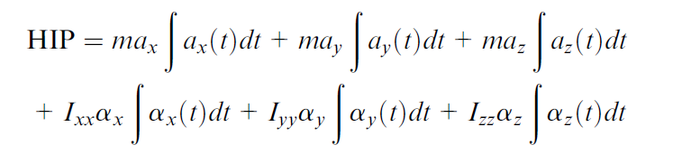
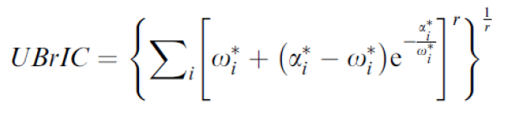
Evaluation
Test standard for evaluation : Folksam Test ++
Simulation Model use : Adult head impactor, SUFEHM, THUMS & GHBMC
Dummy used : Hybrid III Head + Neck 50%-ile Male.
Injury Criteria : HIC, BRIC, uBrIC, GAMBIT & HIP
Threshold : Rotational kinematics injury threshold (Simms and Wood et al.)

Slide 9
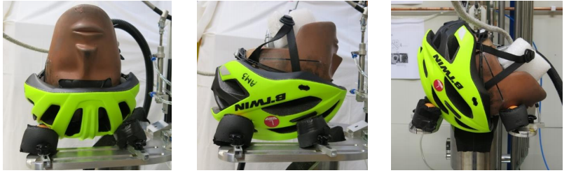
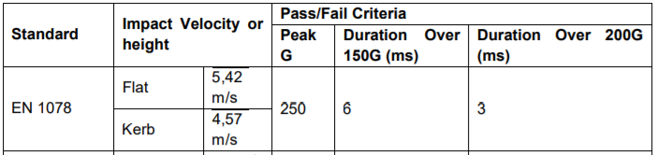
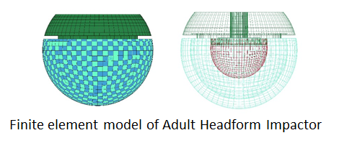
Test Procedures
Folksam Oblique Impact Test Components
Tests | VELOCITY | ANGLE (deg) | DESCRIPTION
Oblique impact A. Contact point on the upper part of the helmet. | 6.0 m/s | 45 | A test that simulates an actual cyclist-vehicle-crash or a single bicycle crash. Rotation around X-axis
Oblique impact B. Contact point on the side of the helmet | 6.0 m/s | 45 | A test that simulates an actual cyclist-vehicle-crash or a single bicycle crash. Rotation around Y-axis
Oblique impact C. Contact point on the frontal side of the helmet. | 6.0 m/s | 45 | A test that simulates an actual cyclist-vehicle-crash or a single bicycle crash. Rotation around Z-axis
Folksam Oblique Impact Test
EN 1078 Shock Absorption Test

Slide 10
Discussion
Advantages
Disadvantages
Low-cost
Protection against both linear and rotational acceleration
Market penetration
Protection may not be adequate
Integrating springs to the current design may have some challenges
The production could take longer time and affect the cost

Slide 11
Conclusion
The current helmets are expensive
An affordable helmet that provide an adequate protection is needed
The new design could be a solution
Several test need to be carried out
It may not provide adequate protection

